Slide 1
MANPOWERGROUP
EMPLOYMENT
OUTLOOK SURVEY
Strongest Hiring Outlooks Reported Since The Launch of the Survey in 2003 – Talent Shortages Remain at 15 Year High in Belgium

Slide 2
TABLE OF CONTENTS
Labor market trends – Belgium
Optimism returns to the Belgian labor market – Net Employment Outlook analysis
Talent Shortages Belgium remain at record level
Greater work flexibility, skills development and increased wages: Top strategies to attract and retain talent
Incentives offered to meet talent shortages aligned across regions worldwide
All talent pools are targeted for reskilling and upskilling in Belgium
When skills development matters most, employers are prioritizing leadership development and shorter technical or soft skills programs
When asked about barriers to upskilling employees, only 22% of employers said funding was the biggest factor
Belgian employers have mixed feelings about the continuation of remote work
About the ManpowerGroup Employment Outlook Survey

Slide 3


LABOR MARKET TRENDS

Slide 4


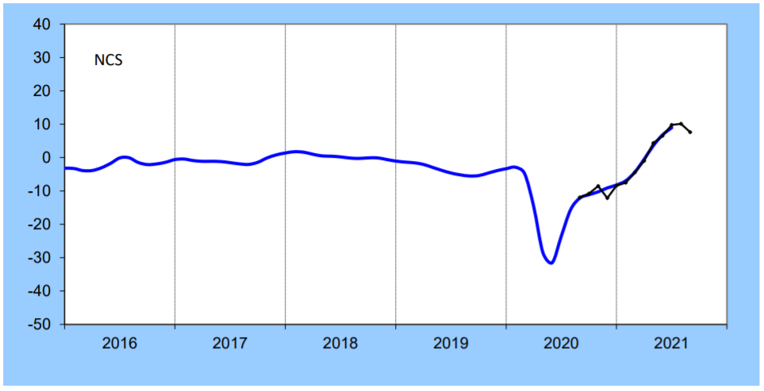
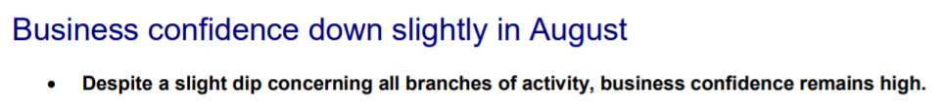


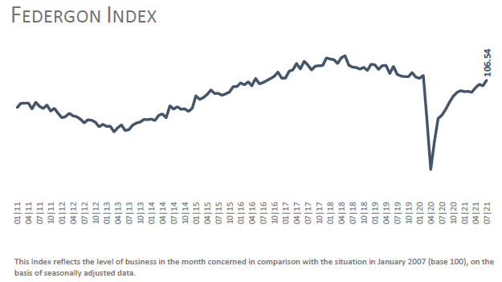

Labor Market Trends

Slide 5


OPTIMISM RETURNS TO THE BELGIAN LABOUR
MARKET
We asked 520 employers about their hiring plans for Q4:
​The recovery in the labor market is expected to accelerate significantly over the next three months in Belgium.

Slide 6

One in two employers in Belgium plans to strengthen its workforce by the end of the year
Of the 520 Belgian employers surveyed by ManpowerGroup at the end of July, one in two (50%) plan to increase their workforce by the end of December 2021, while one in five (20%) plan to reduce headcount. 28% of employers surveyed are forecasting no change. After seasonal adjustment, the Net Employment Outlook rises to a very optimistic value of +30%, the fifth consecutive quarterly increase.
50% PLAN TO HIRE
+30%
NET EMPLOYMENT OUTLOOK
20% EXPECT TO LAY OFF WORKERS
28% PLAN TO KEEP WORKFORCE LEVELS STEADY
2% UNDECIDED

Slide 7
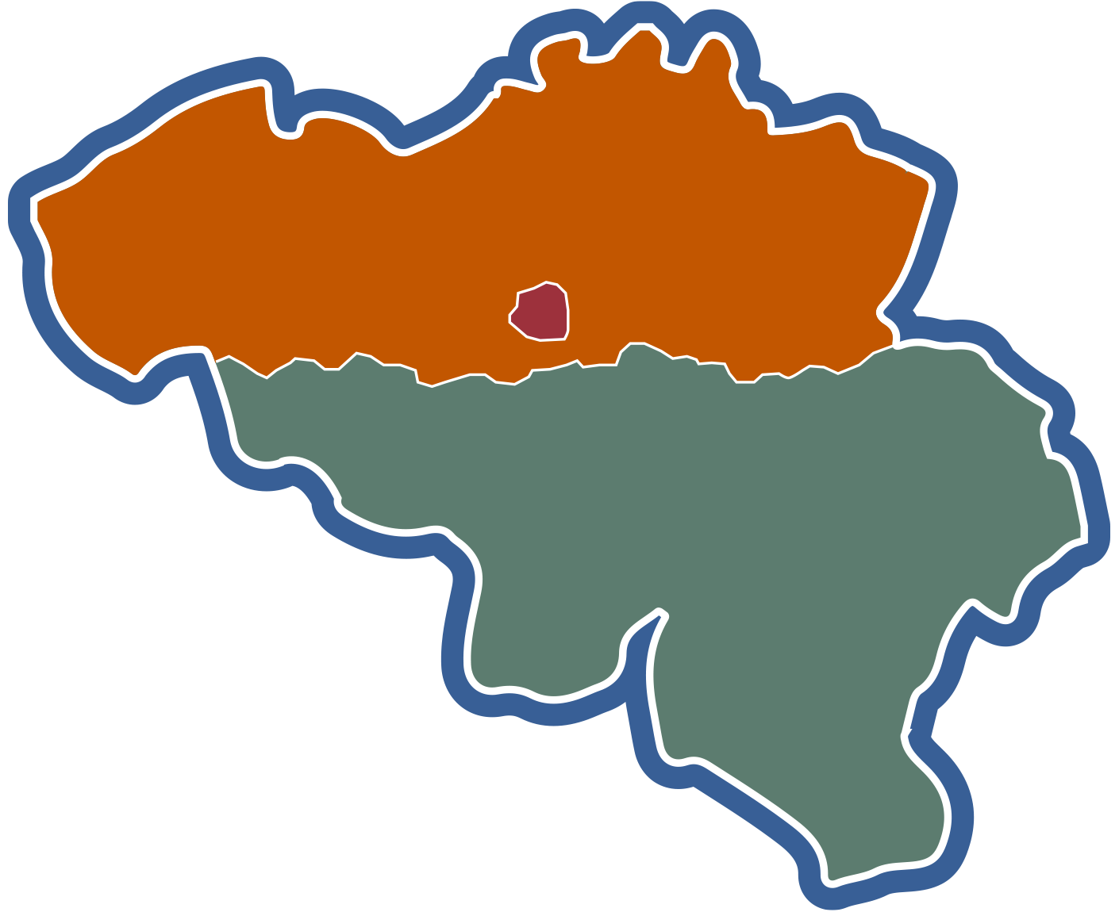

Optimism in all three regions
According to the survey results, employers in all three region anticipate strong labor markets and net employment growth over the next quarter: + 33% in Wallonia, + 32% in Flanders and + 27% in Brussels.
Hiring plans are up sharply in all three regions, both in comparison with the previous quarter and with the same period last year.
Q4
Q3
Q4
Q3
Q4
Q3
Q4
Q3
BELGIUM
FLANDERS
BRUSSELS
WALLONIA

Slide 8
Job gains forecast in all industry sectors surveyed
Workforce gains are forecast in all seven industry sectors for which data is available during the fourth quarter of 2021. Finance, insurance, real estate and business services sector employers expect the strongest hiring pace reporting a robust Net Employment Outlook of +38%.
Q4
Q3
Q4
Q3
Q4
Q3
Q4
Q3
Q4
Q3
Q4
Q3
FINANCE & BUSINESS
SERVICES
WHOLESALE &
RETAIL TRADE
MANUFACTURING
PUBLIC, HEALTH, EDUCATION & SOCIAL
PROFESSIONAL & BUSINESS SERVICES
**
Q4
Q3
Q4
Q3
Q4
Q3
Q4
Q3
Q4
Q3
Q4
Q3
*Agriculture & Fishing; Electricity, Gas & Water; Mining & Quarrying industries
**No data available for Q4
CONSTRUCTION
TRANSPORT
& LOGISTIC
OTHER PRODUCTION*
RESTAURANT
& HOTELS
INFORMATION
OTHER

Slide 9

Employer confidence increases in line with company size
The Net Employment Outlook shows an increasing value in line with the size of the company
Q4
Q3
Q4
Q3
Q4
Q3
Q4
Q3
# of Employees
MICRO
<10
SMALL
10-49
MEDIUM
50-249
LARGE 250+

Slide 10

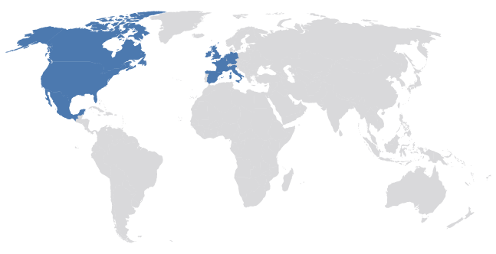

Strongest global hiring outlooks reported since beginning of the COVID-19 pandemic
The Strongest & Weakest Hiring Prospects for Q4 2021:
Record Hiring Intentions Globally:
11 Markets reported their highest hiring outlook since the survey began in 1962.
+48%
+44%
+40%
Strongest
U.S.
INDIA
CANADA
-2%
-2%
+1%
Weakest
CANADA, MEXICO, U.S., BELGIUM, FRANCE, GERMANY, IRELAND, ITALY, NETHERLANDS, SPAIN, U.K.
PANAMA
SOUTH AFRICA
SINGAPORE

Slide 11
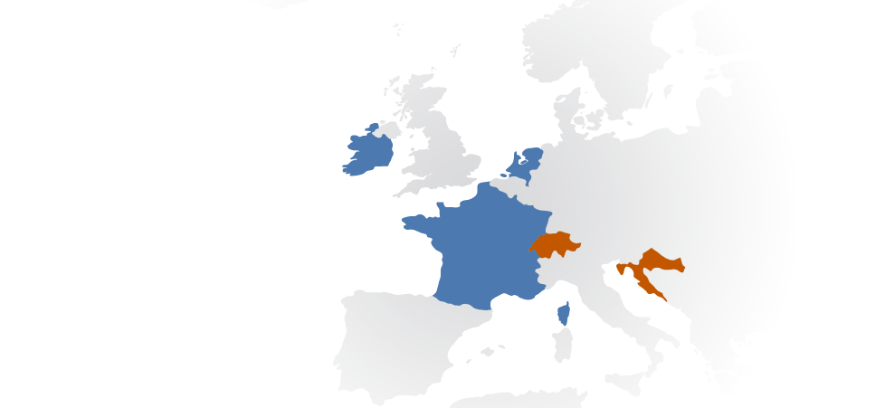
EMEA Employers (Europe, Middle East, Africa) report their strongest quarter since the pandemic began, with positive hiring intentions in 25 of 26 countries
Hiring intentions improve in all 26 countries when compared with Q4 2020 and improve in 20 when compared to Q3 2021.
Employers in all seven industry sectors in France (+37%) report their strongest hiring intentions since the survey began 18 years ago.
In all seven UK (+32%) industry sectors, employers report their strongest hiring intentions since 2008.
Optimism in Germany (+28%) and Italy (+28%).
STRONGEST HIRING INTENTIONS:
Netherlands (+40%), France (+37%) and Ireland (+34)
WEAKEST HIRING INTENTIONS:
South Africa (-2%), Croatia (+2%)
and Switzerland (+8%)
(South Africa)

Slide 12


TALENT SHORTAGES
IN BELGIUM REMAIN AT RECORD LEVEL
77% of employers in Belgium cannot find the skills that they need. This figure is a
15-year-high, now running for
2 consecutive quarters.

Slide 13

COVID-19 is reshaping in-demand skills
The covid crisis and the acceleration of digitization have put skills under pressure.
Technology-related functions remain in high demand and the demand for logistics profiles has been boosted by the rise of e-commerce.
As life returns to a certain normality, demand is increasing in the manufacturing, hospitality, tourism and leisure sectors, allowing them to recover from the severe impact of the health crisis.
.
83%
77%
59%
48%
36%
27%
27%
22%
24%
24%
13%
2010
2011
2012
2013
2014
2015
2016
2018
2019
Q3 2021
Q4 2021
Notes:
Q2. Currently, how much difficulty are you having filling jobs due to lack of skilled talent?
1. A lot of difficulty
2. Some difficulty
3. No difficulty
4. Don’t know / Not stated

Slide 14
Employers in all three regions of Belgium continue to have difficulty finding the right talents
The talent shortages remain at 15-year high in all three regions of the country, for the 2 consecutive quarters
Q4
Q3
Q4
Q3
Q4
Q3
Q4
Q3
BELGIUM
FLANDERS
BRUSSELS
WALLONIA

Slide 15
The global talent shortage remains high as employers still face hiring challenges
of employers globally report difficulty finding the talent they need
69%
79.8%
COUNTRY AVERAGE
70.2%
COUNTRY AVERAGE
44.3%
COUNTRY AVERAGE
HIGH DIFFICULTY
AVERAGE DIFFICULTY
LOWER DIFFICULTY
India, Romania, Singapore, Bulgaria, France, Japan, Belgium, Germany, South Africa, Italy, Spain
Mexico, Netherlands, Poland, Slovakia, U.S., Canada, Greece, Ireland, Hong Kong, U.K., Finland, Hungary, Sweden, Austria, Turkey, Norway, Taiwan, Israel
Australia, Czech Republic, Portugal, Slovenia, Croatia, Switzerland, Brazil, Guatemala, Argentina, Peru, Costa Rica, Panama, Colombia, China

Slide 16


The success of the vaccination campaign and the easing of health measures have strengthened the confidence of employers in Belgium and around the world : the Net Employment Outlook is at an all-time high in Belgium (+30%), as it is in eleven other countries surveyed. At the same time, employers are not able to fill their vacancies quickly enough due to talent shortages, which remain at 15-years record level in Belgium (77%) and in all three regions of the country.
The results of our survey clearly indicate that we are in a ‘candidate market’ meaning businesses are competing for the best talent by implementing concrete attraction and retention strategies. A new era of work is emerging, based on the individual choices of workers who have taken back control and who expect employers to adapt to their expectations, especially the most qualified.
Philippe Lacroix
Managing Director ManpowerGroup BeLux
Q4
2021
“
”

Slide 17


GREATER WORK FLEXIBILITY, SKILLS DEVELOPMENT AND INCREASED WAGES:
Top strategies to attract and retain talent in Belgium

Slide 18
Belgian companies are offering multiple incentives to attract & retain
In-demand talent
37%
41%
30%
31%
OFFER TRAINING, SKILLS DEVELOPMENT OR MENTORING
OFFER MORE FLEXIBLE WORK SCHEDULES
INCREASED WAGES
OFFER MORE FLEXIBLE WORKING LOCATIONS
15%
23%
19%
10%
OFFER INCENTIVES (JOINING BONUSES)
OFFER MORE NON-FINANCIAL BENEFITS (VACATION)
LOWER JOB SKILLS OR EXPERIENCE REQUIREMENTS
ELIMINATE JOB SCREENING

Slide 19


INCENTIVES OFFERED TO MEET TALENT SHORTAGES ALIGNED ACROSS REGIONS WORLDWIDE
41% of employers globally are offering training, skills development or mentoring as a top incentive to secure the talent they need.

Slide 20
Incentives offered by employers fairly aligned across regions
The strongest incentive provided by employers across all regions is to offer training, skills development or mentoring. Organizations in South and Central America offer less incentives than other regions.
SOUTH/CENTRAL AMERICA
EUROPE/MIDDLE EAST/AFRICA
NORTH AMERICA
ASIA PACIFIC
Offer Training, Skills Development or Mentoring
Increased Wages
Offer More Flexible
Working Locations
Lower Job Skills or Experience Requirements
30%
43%
39%
44%
19%
32%
38%
33%
18%
30%
31%
28%
13%
21%
19%
22%

Slide 21

ALL TALENT POOLS
ARE TARGETED
FOR RESKILLING AND UPSKILLING IN BELGIUM

Slide 22
All Talent Pools are Targeted for Reskilling and Upskilling in Belgium
Students or
recent graduates
Existing employees
in low skilled roles
Existing employees
in higher skilled roles
Workers over 50 years old
Under-represented groups
(E.G minorities)
None of these groups /
Don’t know

Slide 23

WHEN SKILLS DEVELOPMENT MATTERS MOST, EMPLOYERS ARE PRIORITIZING LEADERSHIP DEVELOPMENT AND SHORTER TECHNICAL AND SOFT SKILLS PROGRAMS

Slide 24

Shorter is Better – Upskilling in Six Weeks or Less is Preferred
Accelerated programs for both technical and soft skills are preferred by nearly 6 out of 10 employers in Belgium.
After ‘jobs, jobs, jobs’, ‘training, training, training’ is becoming the new mantra in the labour market.
Compulsory Training Including Compliance
Manager & Leader Development Training
Accelerated Upskilling Programs in Technical Skills (6 weeks or less)
Upskilling Programs in Soft Skills (6 weeks or less)
Career
Coaching
Upskilling Programs in Technical Skills (more than 6 weeks)
Upskilling Programs in Soft Skills (more than 6 weeks)
Diversity &
Inclusion Training

Slide 25

WHEN ASKED ABOUT BARRIERS
TO UPSKILLING EMPLOYEES, ONLY 22% OF EMPLOYERS SAID FUNDING WAS THE BIGGEST FACTOR
53% of Belgian employers shared that knowledge and
stakeholders are needed to improve access to upskilling programs.

Slide 26

It takes many internal & external stakeholders to improve access to upskilling programs – Barriers to upskilling employees
Money
Time
Knowledge or Strategy on What Areas to Skill Workforce
Lack of Desire to Increase Upskilling Programs
53% Upskilling barriers are due to a breakdown in what and how to fulfil employee needs
Access to the Right Upskilling/Training Partners
Lack of Understanding of Upskilling Needs Within our HR Team
Leadership Commitment
Other Barriers/Don’t Know

Slide 27

BELGIUM EMPLOYERS
HAVE MIXED FEELINGS ABOUT THE CONTINUATION OF REMOTE WORKING
Not more than 50% of Belgian employers perceive their managers are feeling positive, resilient, unconcerned or energized in response to remote working.

Slide 28
Belgian employers have mixed feelings about the continuation of remote working
As hybrid and remote work continue to be the norm, despite the pandemic easing in many markets, Belgian employers report differing moods from their senior managers.
.
Positive
Stressed
Resilient
Isolated
Burned Out
Anxious
50%
are feeling
positive, resilient, energized or unconcerned
(NET)
48%
are feeling stressed, isolated, burned out, anxious, depressed or fearful
(NET)
Energized
Unconcerned
Depressed
Fearful
Something Else/
Don’t Know

Slide 29
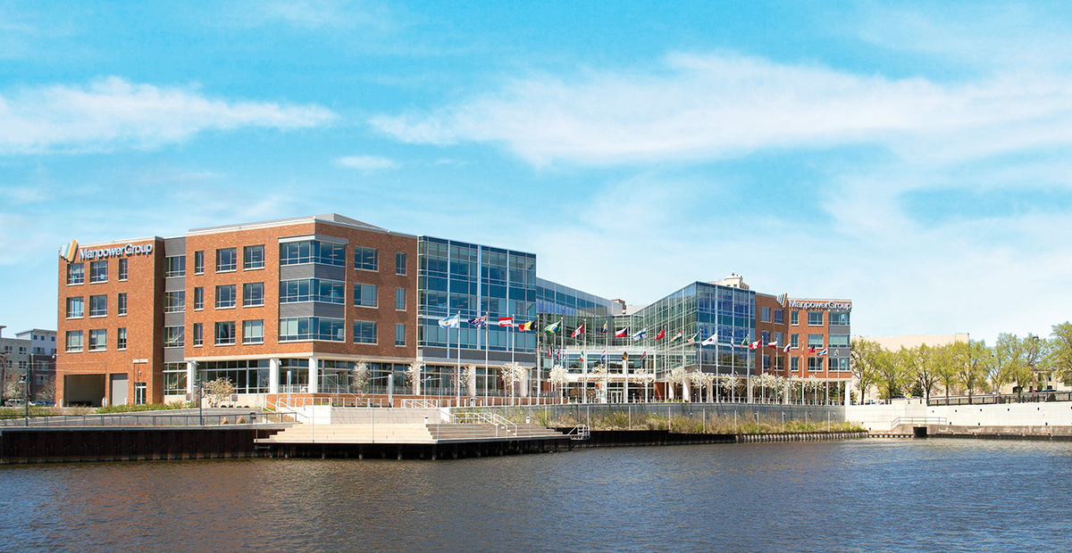
THE MANPOWERGROUP EMPLOYMENT OUTLOOK SURVEY

Slide 30


About the ManpowerGroup Employment Outlook Survey
Change in the Survey Methodology in Q4 2021
The methodology used to collect the data for the Employment Outlook changed for [Q4 2021 / Q1 2022]. Respondents in prior quarters were contacted via telephone.
With the shift to remote working and much higher reliance on the internet, survey responses are now being collected online.
Respondents are members of double opt-in online panels and are incentivized to complete the survey.
The question asked and the respondent profile remains unchanged. Size of organization and sector are standardized across all countries to allow international comparisons.
Notes:
Additional notes on the Q4 2021 Analysis:
Analysis was done on the raw, non-seasonally adjusted data provided to Reputation Leaders by InfoCorp in August 2021.
Data was weighted by InfoCorp so that all countries retained their original sizes excepting the US and India which were weighted down to 2000 to avoid overly skewing the sample.
Sectors and organization sizes were predefined and applied as given.
On Q3, we ran a principle component analysis to identify any options that could be statistically grouped together. This resulted in “Lower the bar” which is the merger of lower job skills or experience and/or eliminate job screening or drug tests.

Slide 31

About the ManpowerGroup Employment Outlook Survey
The ManpowerGroup Employment Outlook Survey is conducted quarterly to measure employers’ intentions to increase or decrease the number of employees in their workforces during the next quarter. ManpowerGroup’s comprehensive forecast of employer hiring plans has been running since 1962 and is one of the most trusted surveys of employment activity in the world. Various factors underpin the success of the ManpowerGroup Employment Outlook Survey:
Unique
It is unparalleled in its size, scope, longevity and area of focus.
Projective: The ManpowerGroup Employment Outlook Survey is the most extensive, forward-looking employment survey in the world, asking employers to forecast employment over the next quarter. In contrast, other surveys and studies focus on retrospective data to report on what occurred in the past.
Independent
The survey is conducted with a representative sample of employers from throughout the countries and territories in which it is conducted. The survey participants are not derived from ManpowerGroup’s customer base.
Robust
For Quarter 4 2021, sample sizes are smaller than other quarters, reflecting the impact of the global health emergency so total number of interviews is significantly lower than normal in some countries. The survey is based on interviews with over 45,000 public and private employers across 43 countries and territories to measure anticipated employment trends each quarter. This sample allows for analysis to be performed across specific sectors and regions to provide more detailed information.
Focused
For more than five decades the survey has derived all of its information from a single question: “How do you anticipate total employment at your location to change in the three months to the end of September 2021 as compared to the current quarter?”
Survey Methodology
The ManpowerGroup Employment Outlook Survey is conducted using a validated methodology, in accordance with the highest standards in market research. The survey has been structured to be representative of each national economy. The margin of error for almost all national, regional and global data is not greater than +/- 5%.
Throughout this report, we use the term “Net Employment Outlook.” This figure is derived by taking the percentage of employers anticipating an increase in hiring activity and subtracting from this the percentage of employers expecting to see a decrease in employment at their location in the next quarter. The result of this calculation is the Net Employment Outlook. Net Employment Outlooks for countries and territories that have accumulated at least 17 quarters of data are reported in a seasonally adjusted format unless otherwise stated. Seasonal adjustments have been applied to the data for all participating countries except Croatia.
Notes:
Additional notes on the Q4 2021 Analysis:
Analysis was done on the raw, non-seasonally adjusted data provided to Reputation Leaders by InfoCorp in August 2021.
Data was weighted by InfoCorp so that all countries retained their original sizes excepting the US and India which were weighted down to 2000 to avoid overly skewing the sample.
Sectors and organization sizes were predefined and applied as given.
On Q3, we ran a principle component analysis to identify any options that could be statistically grouped together. This resulted in “Lower the bar” which is the merger of lower job skills or experience and/or eliminate job screening or drug tests.

Slide 32
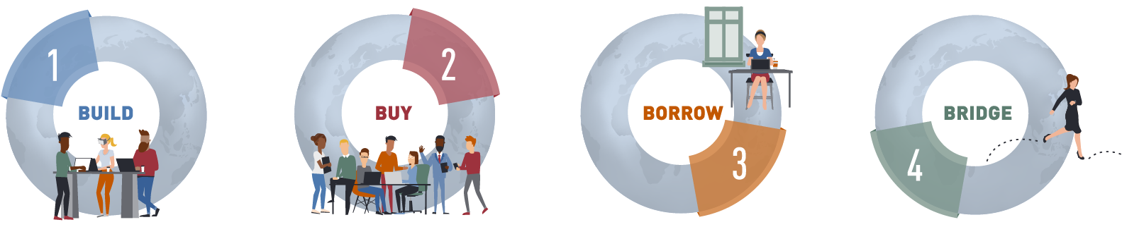
A holistic Workforce Strategy includes Build, Buy, Borrow and Bridge
Invest in learning and development to grow your pipeline
Go to the external market to attract the talent that cannot be built-in-house
Cultivate communities of talent outside the organization
Help people move on or move up to new roles within the organization

Slide 33






ManpowerGroup provides Innovative Workforce Solutions across the entire Talent Life Cycle
Workforce Consulting & Analytics
Workforce Management
Talent Resourcing
Career Management
Career Transition
Attracting Top Talent

Slide 34
EXPLORE THE DATA: manpowergroup.be manpowergroup.com/meos

